Slide 1
Python basics
Python is a general-purpose interpreted, interactive, object-oriented, and high-level programming language.
Interpreted:- Python is processed at runtime by the interpreter. i.e. you do not need to compile your program before executing it
Interactive :-You can interact with the interpreter directly to write your programs
Portable :- It can run on wide range of hardware Platforms
Object-Oriented :- Python supports Object-Oriented style and Procedural Paradigms
Known as Beginner’s Language :- It’s a great language for the beginner-level programmers
Provides very high-level dynamic data types and supports dynamic type checking.
Has a huge collection of standard library

Slide 2
Python basics(2)
Characteristics of Python
It supports functional and structured programming methods as well as OOP.
It can be used as a scripting language or can be compiled to byte-code for building large applications.
It provides very high-level dynamic data types and supports dynamic type checking.
It supports automatic garbage collection.
It can be easily integrated with C, C++, COM, ActiveX, CORBA, and Java.

Slide 3
Python basics(3)
Installing Python
Python distribution is available for a wide variety of platforms.
Here are the steps to install Python on Windows machine.
Open a Web browser(chrome, Mozilla etc. ) and go to https://www.python.org/downloads/.
Follow the link for the Windows installer python 3.10.6(latest version)
Save the installer file to your local machine and then run it to find out if your machine supports MSI.
Run the downloaded file. This brings up the Python install wizard, which is really easy to use. Just accept the default settings, wait until the install is finished, and you are done.

Slide 4
Python basics (4)
Running Python
There are different ways to run python script
Script from the Command-line(Python Interpreter) :- to run python shell
open the command prompt or windows power shell
write the word python in the command line and press enter.
A python prompt comprising of three greater than >>> appears.
enter a single statement and get the result.
N.B: Python Shell executes a single statement
to execute multiple statements, create a python file with .py extension and write scripts

Slide 5
Python basics (5)
Running Python(continued)
By using Integrated Development Environment:
when python is installed, a program called IDLE(Integrated Development and Learning Environment) is also installed along with it.
IDLE can be used to execute a single statement (Python Shell window)and also to create, modify, and execute Python scripts(Editor window)
IDLE python shell window
To start an IDLE interactive shell, search for the IDLE icon in the start menu and double click on it.
start writing and executing codes
The window editor
To start using the editor window , create a new file by selecting File -> New File from the menu.
Enter multiple statements and save the file with extension .py using File -> Save.
finally, press F5 to run the script in the editor window.

Slide 6
Python basic (6)
Jupyter note book
The other most common way of writing python scripts is using Jupyter note book
Jupyter Notebook is an open-source web-based text editor used to write, edit and execute programs, display outputs and writing texts.
When you first install Python, Jupyter does not come as a default installation along with the python . It has to be installed separately.
To install Jupyter, write “ pip install Jupyter in the command prompt window
After successful installation, we can start the Jupyter editor from the command by typing Jupyter notebook
The Jupyter note book will be opened in your default browser( chrome, Firefox, safari etc.)
Jupyter will display files and folders from the Python installation folder.
You can create, open, and execute python scripts from the appropriate folders.
Start a new notebook by choosing Python 3 from the "new" dropdown

Slide 7
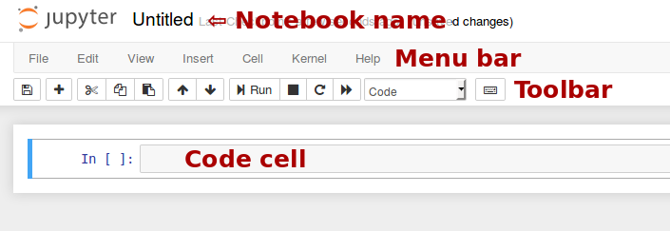
Python basics (7)
Jupyter note book
When you create a new notebook document, you will be presented with the notebook name, a menu bar, a toolbar and an empty code cell.
Menu bar: The menu bar presents different options that may be used to manipulate the way the notebook functions.
Toolbar: The tool bar gives a quick way of performing the most-used operations within the notebook, by clicking on an icon.
Code cell: the default type of cell; read on for an explanation of cells.

Slide 8
Popular applications for Python
Web Development
Data Science — including machine learning, data analysis, and data visualization
Scripting
Game Development
CAD Applications
Embedded Applications

Slide 9
Python syntax basics
Statements in Python typically end with a new line. Python does, however, allow the use of the line continuation character (\) to denote that the line should continue.
Statements contained within the [], {}, or () brackets do not need to use the line continuation character.
Use the semicolon ; to separate multiple statements in a single line.
In a Python script, the symbol # indicates the start of a comment line. It is effective until the end of the line in the editor.
if 100 > 99 and 200 <= 300 and True != False:
print('Hello World!')
if 100 > 99 and\
200 <= 300 and \
True != False:
print('Hello World!')
days = ['Monday', 'Tuesday', 'Wednesday',
'Thursday', 'Friday']
print('id: ', 1);print('First Name: ', ‘Amare');print('Last Name: ', 'Jobs')
# this is a comment
print("Hello World")
print("Welcome to Python Tutorial") # to say welcome.

Slide 10
Python syntax basics
Python accepts single ('), double (") and triple (''' or """) quotes to denote string literals, as long as the same type of quote starts and ends the string.
The Python program can contain variables, functions, classes, modules, packages, etc. Identifier is the name given to these programming elements.
Identifiers in Python are case sensitive, which means variables named age and Age are different.
Class names should use the Title Case convention. It should begin with an uppercase alphabet letter e.g. MyClass, Employee, Person
Function names should be in lowercase. Multiple words should be separated by underscores, e.g. add(num), calculate_tax(amount)
Module and package names should be in lowercase
e.g., mymodule, tax_calculation
word = 'word'
sentence = "This is a sentence.“
paragraph = """This is a paragraph. It is made up of multiple lines and sentences."""

Slide 11
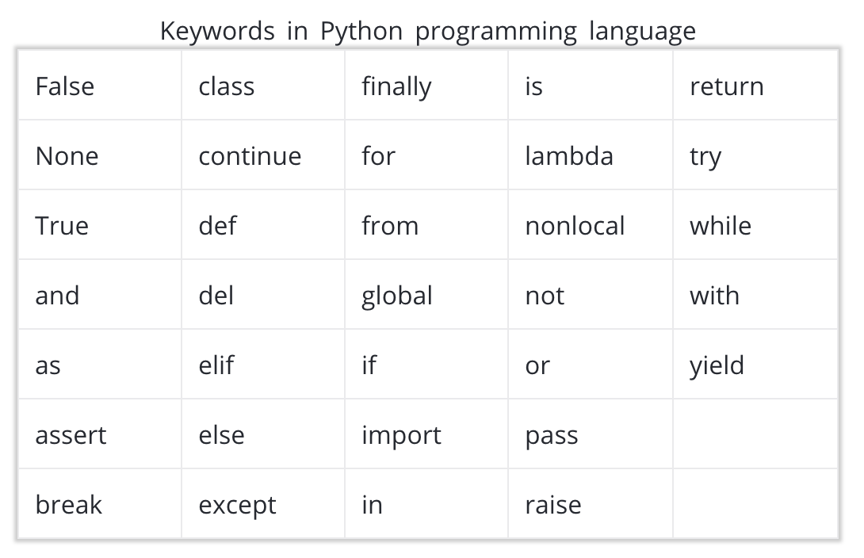
Python key words
There are words that have important purposes in Python and are called keywords(reserved words).
These are reserved words and you cannot use them as constant or variable or any other identifier names. Except for the first three (False, None and True), the other keywords are entirely in lowercase.

Slide 12
Variables in python
.
In Python, variable is the name given to a value, so that it becomes easy to refer a value later on.
The equal sign (=) is used to assign values to variables.
e.g >>> n = 10
In any case, whatever term is on the left side, is now a name for whatever value is on the right side.
Once a value has been assigned to a variable name, you can access the value from the variable name.
During variable assignment, variable names should be descriptive ,
Only use ordinary letters, numbers and underscores in your variable names.
They can’t have spaces, and need to start with a letter or underscore
Variable names cannot be a reserved keywords in Python.
Variable names in Python are case sensitive. So, NAME, name, nAME, and nAmE are treated as different variable names
The pythonic way to name variables is to use all lowercase letters and underscores to separate words.
my_height = 168
my_weight = 65
my_color = ‘black’
my height = 168
MYWEIGHT = 65
Mycolor = ‘black’

Slide 13
Arithmetic operations in variables
Different operations can be performed on variables using various operators based on the type of variables.
For example, the + operator sums up two integer variables, whereas it concatenates two string type variables, as shown below.
Other mathematical operations that cab be performed in python are
Subtraction (-)
Multiplication (*)
Division(/)
Mod (%) : gives us the remainder after dividing
Exponentiation (**)
// : Divides and rounds down to the nearest integer
>>> x='Hello '
>>> y='World‘
>>> x+y
'Hello World‘
>>> x=5
>>> y=4
>>> x+y
9
>>> x=27
>>> y=4
>>> x//y
6
>>> x=10
>>> y=4
>>> x%y
2
>>> x=5
>>> y=4
>>> x*y
20

Slide 14
Exercise
My electricity bills for the last three months have been 230 birr, 320 birr and 640 birr. What is the average monthly electricity bill over the three month period? Write an expression to calculate the mean, and use print() to view the result.
The comments in this quiz (the lines that begin with #) have instructions for creating and modifying variables. After each comment write a line of code that implements the instruction. Note that this code uses scientific notation to define large numbers. 4.445e8 is equal to 4.445 * 10 ** 8 which is equal to 444500000.0.
# The current volume of a water reservoir (in cubic meters)
reservoir_volume = 4.445e8
# The amount of rainfall from a storm (in cubic meters)
rainfall = 5e6
# decrease the rainfall variable by 10% to account for runoff
# add the rainfall variable to the reservoir_volume variable
# increase reservoir_volume by 5% to account for storm water that flows into the reservoir in the days following the storm
# decrease reservoir_volume by 5% to account for evaporation
# subtract 2.5e5 cubic metres from reservoir_volume to account for water that's piped to arid regions.
# print the new value of the reservoir_volume variable

Slide 15
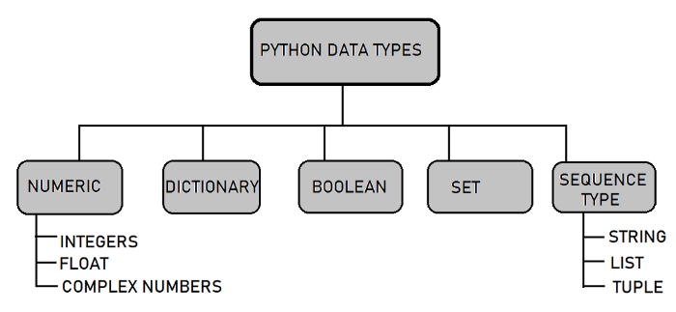
Python Data Types
Data Types represent the kind of value variables can hold and what all operations can be performed on a particular data.
You can check the type by using the ”type” function
you can create a value that follows the data type by using the following syntax:
>>> x = 10
>>> print(type(x))
int
>>>y = float(4)
>>>print(type(y))
Float

Slide 16
Python Number Types: int, float, complex(1)
Python includes three numeric types to represent numbers: integers, float, and complex number
In Python, integers are zero, positive or negative whole numbers without a fractional part and having unlimited precision, e.g. 0, 100, -10.
All integer literals or variables are objects of the ”int” class. Use the type() method to get the class name
The int() function converts a string or float to integer.
In Python, floating point numbers (float) are positive and negative real numbers with a fractional part denoted by the decimal symbol . or the scientific notation E or e, e.g. 1234.56, 3.142, -1.55, 0.23.
>>> x = 100
>>>type(x)
<class 'int'>
>>> x = 100.21
>>>type(x)
<class ‘float'>
>>> int(x)
100
>>> f=1.2
>>> type(f)
<class 'float'>

Slide 17
Python Number Types: int, float, complex(2)
The float()function covert integer or string into float type numbers.
A numeric object of one type can be converted in another type using the following function
>>>x = 5
>>> float(x)
5.0
Built-in Function | Description
int | Returns the integer object from a float or a string containing digits.
float | Returns a floating-point number object from a number or string containing digits with decimal point or scientific notation.
complex | Returns a complex number with real and imaginary components.
hex | Converts a decimal integer into a hexadecimal number with 0x prefix.
oct | Converts a decimal integer in an octal representation with 0o prefix.
pow | Returns the power of the specified numbers.
abs | Returns the absolute value of a number without considering its sign.
round | Returns the rounded number.

Slide 18
Python strings

